Slide 1
Security Tools
Final Project

Slide 2
Alfred CISY Hospital
Employees | 200
Services | AD DS, Web sites, File sharing, Email Server
Internal to External connection: | Outside connection is provided by using Cisco router NAT
External to internal Access | none, with the exception of the web server
Internal Network Access: | Internal users IP addresses are assigned using DHCP. While server IP addresses are assigned manualy
Allowed Network Service and Protocol and Ports: | Web services: HTTP, HTTPS, Port 80, Port 443 DNS - port 53

Slide 3
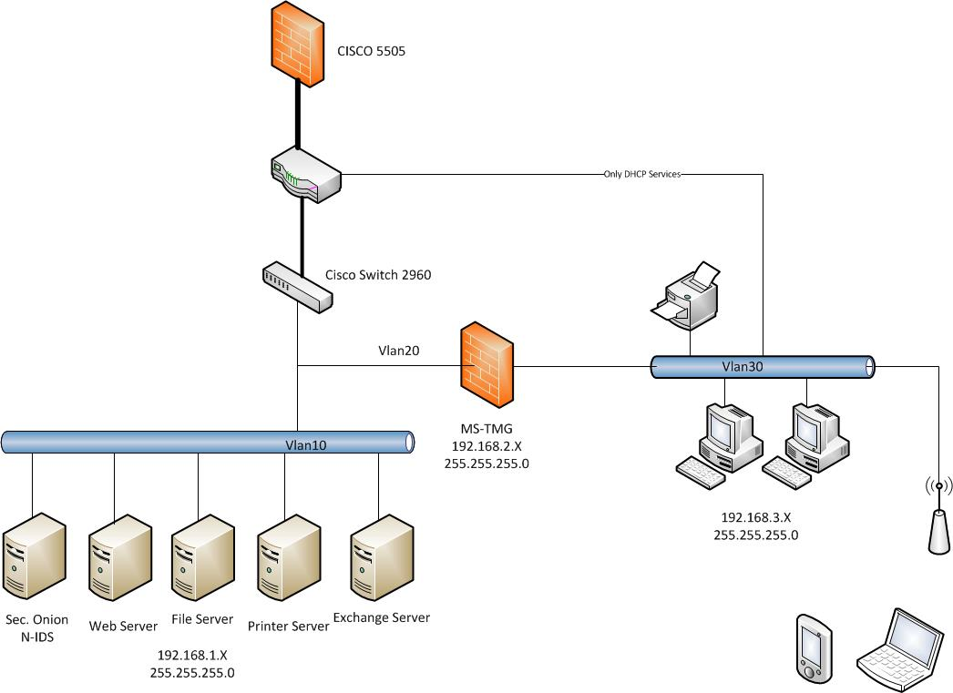

Slide 4
Layers
Ring 1: Internet Edge
ASA Firewall
Ring 2: Backbone Edge
NIDS Security Onion
Ring 3: Asset Network Edge
TMG
Ring 4: Host Based Security Ring

Slide 5
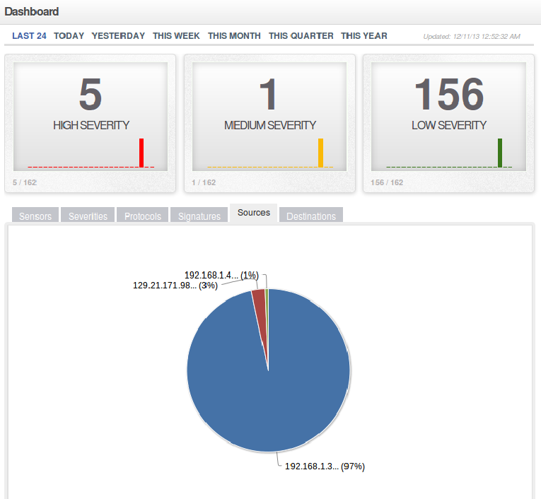
Snorby NMAP Detection
NMap scan from the web server detected by snorby

Slide 6
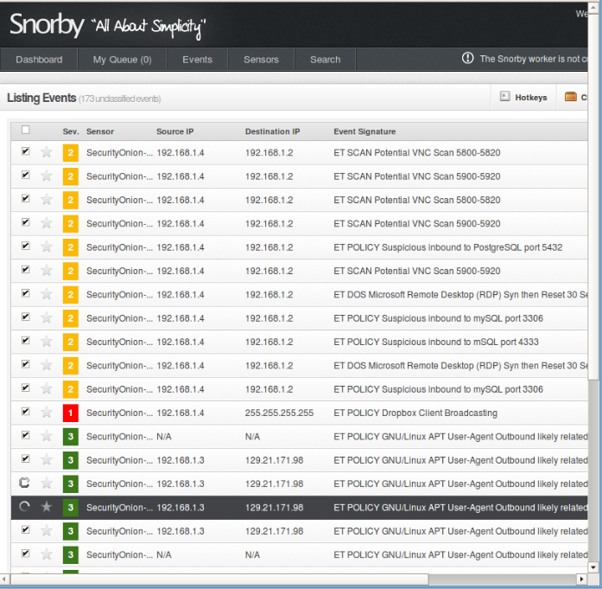

Slide 7
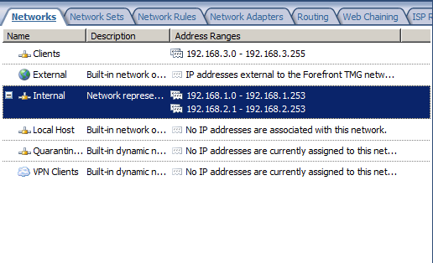
TMG firewall

Slide 8
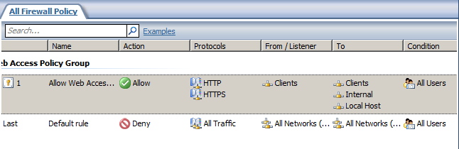
TMG Firewall Policy
allows clients to access services the use protocols : HTTP, HTTPS

Slide 9
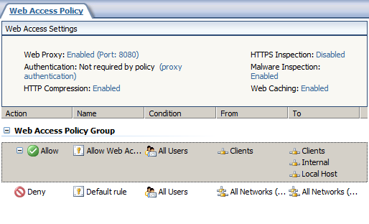
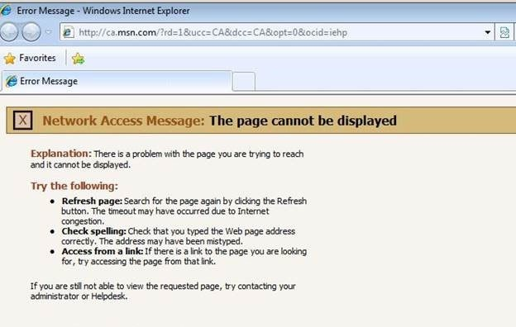
TMG Web Access Policy

Slide 10
Summary
Subnetting with router firewall
Security Onion IDS
TMG firewall with routing

